Slide 1

BULL STOCK
By,
TRIV2VER

Slide 2
INTRODUCTION
What Does stock means?
What does Stock exchange means?
Who can do stock exchange?
What’s its scalability?

Slide 3
Introduction
Bull stock is an Framework for both android app and web app.
It will allow student’s to get hands on with virtual stock trading.
An app for future fluent trading.

Slide 4
The Team
List CEO and key management by name.
Include previous accomplishments to show that these are people with a record of success.
Summarize number of years of experience in this field.

Slide 5
Problem being solved
An knowledge bridge between students and stock exchange.
Measuring and controlling the Risk by analysis using parse API’s and google chart API’s.
Educating Students for better money control’s.

Slide 6
Technology Stack
Can be listed in 2 toppics.
One, Front-End
Android app
Android bootstrap
Web application
Javascript
Second,Back-end
Second, Back-end
Parse API calls.

Slide 7
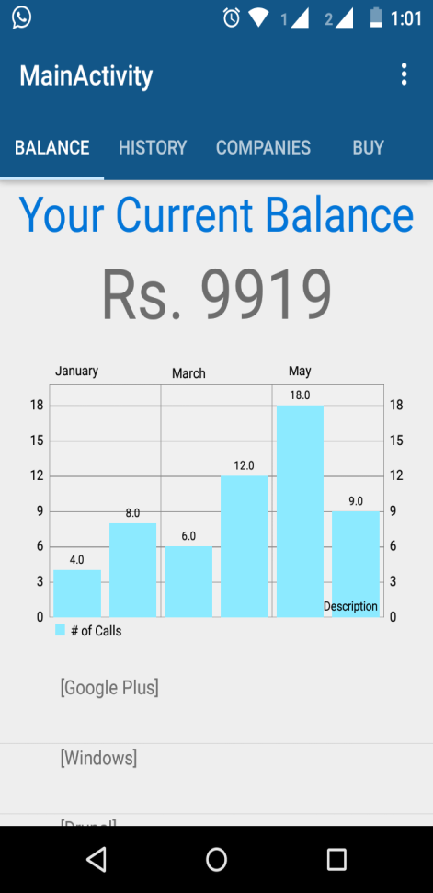
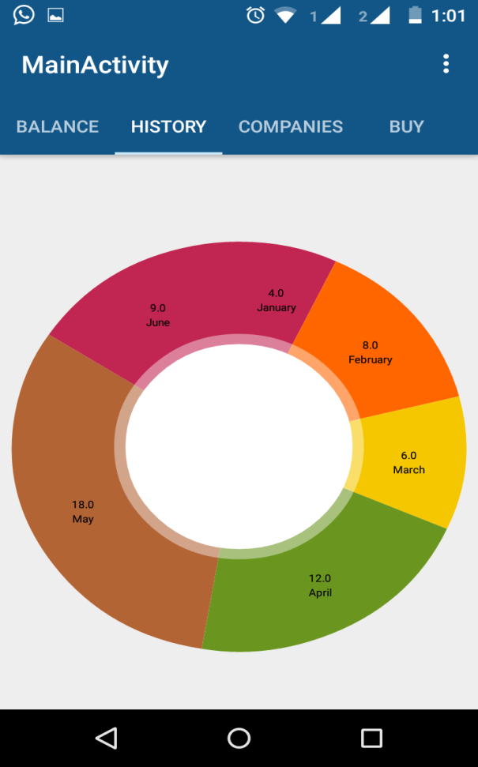
Screenshots

Slide 8
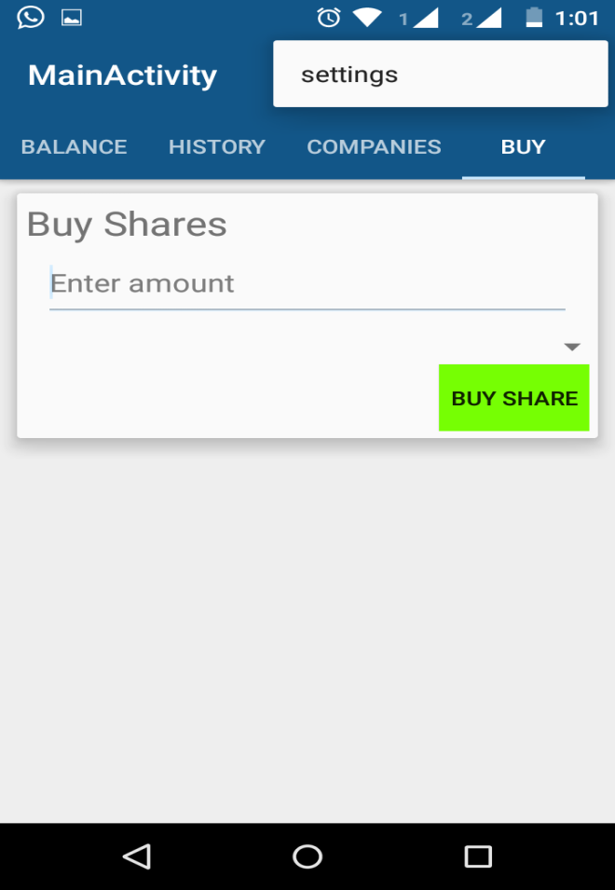
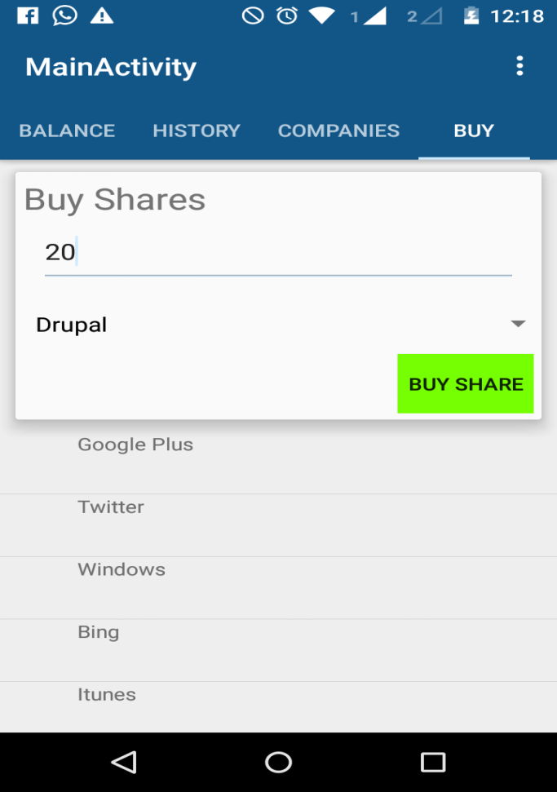
Screenshots

Slide 9
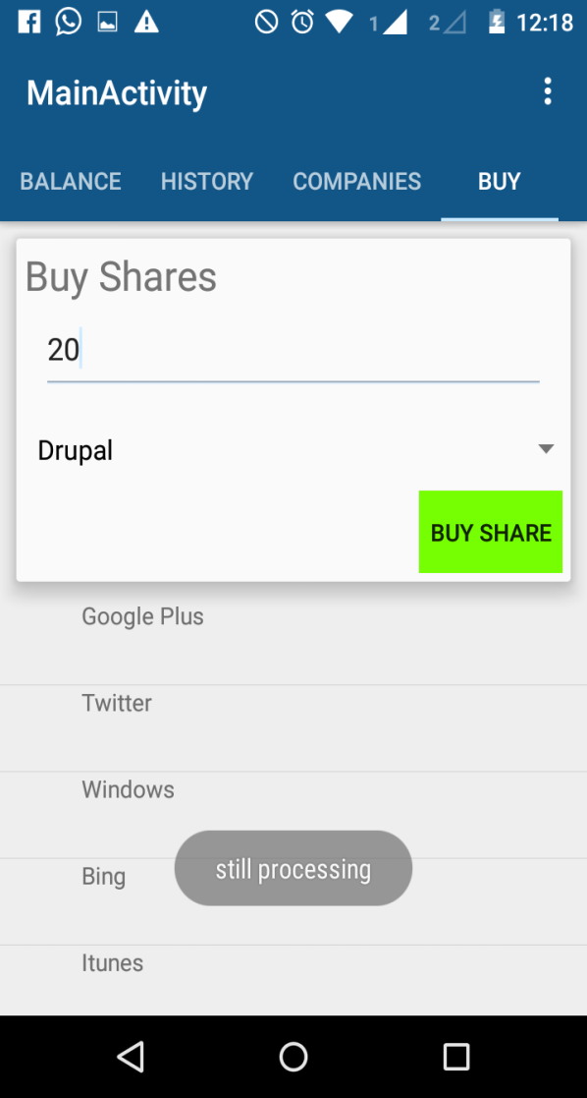
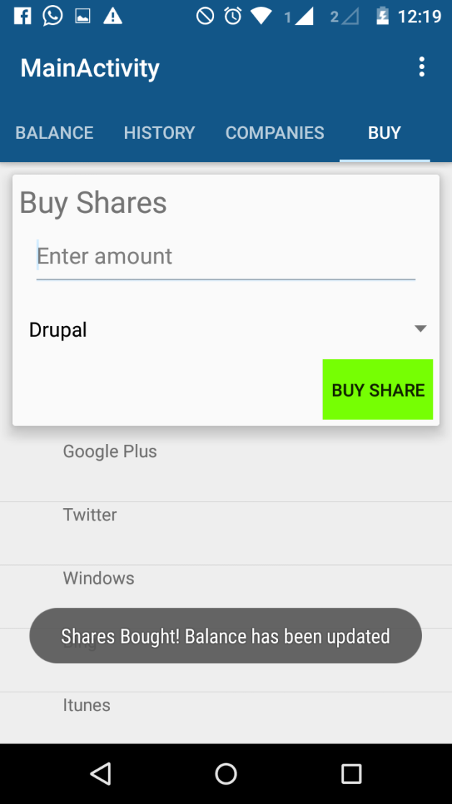
Screenshots

Slide 10
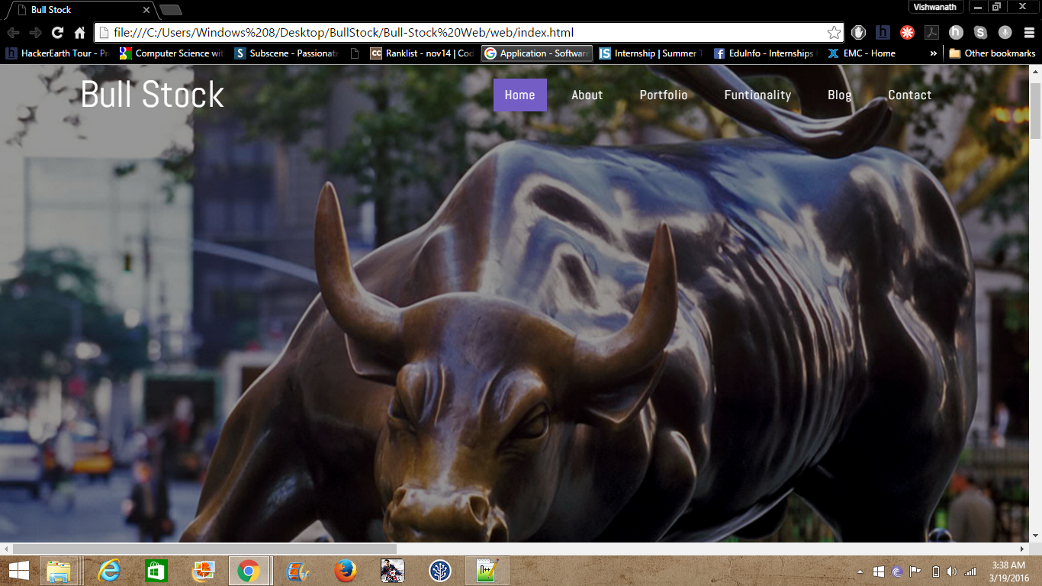
Screenshots

Slide 11
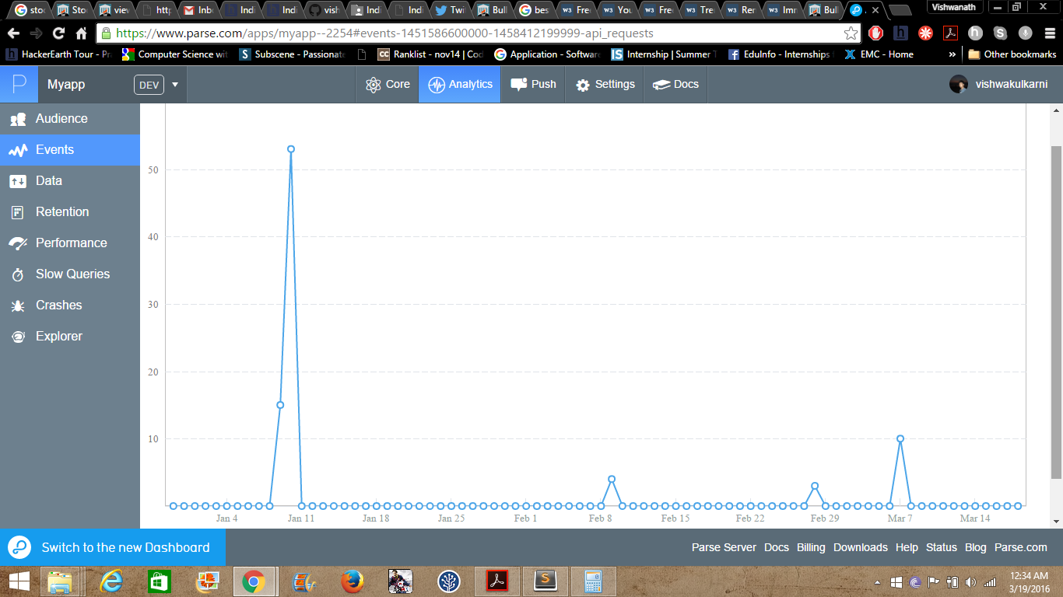
ScreenShots

Slide 12
Challenges faced
Storing data and getting its analytics.
Maintaining ACID properties for buying and selling of shares.
Analysing the data in android app.

Slide 13
Future Scope
Oh! There is very vast scope for this app.
Limitless because students are india’s future.
Wonder for real stock exchange happening.
Nearly 1511 colleges are there in india and 200 students per college, which will account for arround
1151*200 = 230200 students every year.
230200/2=115100 * 10rs =11511000 per year.

Slide 14
Future Scope
Few more additions.
Complete web portal with back end handling brokers.
Investment from students to Start-ups.
More investments less risk.

Slide 15
Thank you
ANY Questions?

Slide 16
Financial Plan
Outline a high-level financial plan that defines your financial model and pricing assumptions.
This plan should include expected annual sales and profits for the next three years.
Use several slides to cover this material appropriately.

Slide 17
Resource Requirements
List requirements for the following resources:
Personnel
Technology
Finances
Distribution
Promotion
Products
Services

Slide 18
Risks and Rewards
Summarize the risks of the proposed project and how they will be addressed.
Estimate expected rewards, particularly if you are seeking funding.

Slide 19
Key Issues
Near term
Identify key decisions and issues that need immediate or near-term resolution.
State consequences of decision postponement.
Long term
Identify issues needing long-term resolution.
State consequences of decision postponement.
If you are seeking funding, be specific about any issues that require financial resources for resolution.

